Slide 1


Pre-Launch Prep for the
New Emerson.com Newsroom
Updated April 2021

Slide 2
What we’re covering today
Snapshot of the new Newsroom
What’s different and what best practices will remain
Content organization
Business as Usual vs. New Processes
Updates needed to prepare for launch

Slide 3
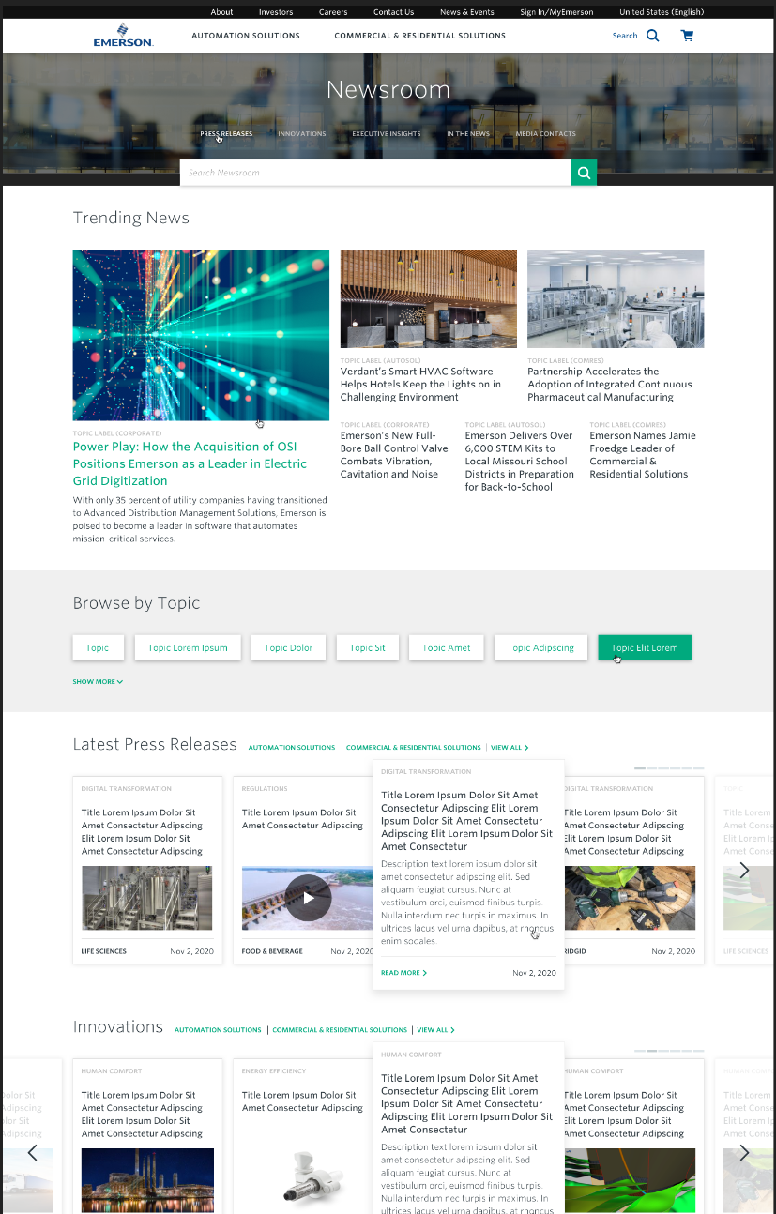
The New Newsroom
The new Newsroom is a robust resource on Emerson.com that is optimized for media and internal stakeholders to access Emerson news, innovations, insights, events and media-friendly information about the company in a seamless, user friendly manner that is aligned with the OneEmerson look, feel and story.

Slide 4
The New Newsroom
WHAT’S DIFFERENT
BEST PRACTICES TO KEEP IN MIND
No more News Teasers!
Tagging, tagging, tagging
Images required
Backend organization matching the frontend
Consistent naming
Complete use of needed component fields
Not filling in unnecessary component fields
Tagging, tagging, tagging
SEO is the bees' knees
Image crop shop talk

Slide 5
Creating and Organizing Pages

Slide 6
Define the News Type
(there can be only 1)
These news types are pan-Emerson and corporate-managed. If you have a piece of content for the Perspectives thought leadership hub or the Innovations stories cache, contact Corporate Marketing/the FH CoreMedia team for publishing logistics.
PRESS RELEASE
IN THE NEWS ALERT
PERSPECTIVES ARTICLE
INNOVATION STORY
Can be an official press release, often also released over "the wire," but may also be any announcement that is not deemed an Innovation Story, Perspective Article, In the News Alert or News Brief
External article that we're mentioned or quoted in
Thought leadership, opinion or insight piece written by our executives and subject matter experts
Long-form feature showcasing our solutions to major industrial or societal problems through advancements across businesses and industries
NEWS BRIEF
Used to create a page of information that needs to be live and searchable, but does not need to appear in any news carousels on the Newsroom homepage

Slide 7
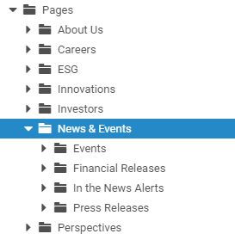
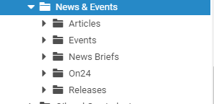
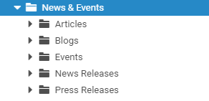
Navigate to the Appropriate Folder According to Platform to be renamed per standards laid out below
CORPORATE
AUTOMATION
COMMERCIAL & RESIDENTIAL
Again, these news types are pan-Emerson and corporate-managed.
  Innovations
  Perspectives
  If you have a piece of content for the Perspectives thought leadership hub or the Innovations stories cache, contact Corporate Marketing/the FH CoreMedia team for publishing logistics.
It is recommended that each platform keep a repository of their Press Releases and In the News Alerts in their file structure, in folders named as such. Existing content that falls into these categories should be reorganized into these folders.
News & Events
  In the News Alerts
  (Articles)
  Press Releases
  (Releases, News Releases, News Briefs, etc.)
Sub-folders by year
Any additional folders needed for other content (i.e., for blogs or events) can be kept in separate folders.
  Blogs
  (if any of these are truly press releases or in the news alerts, reorganize into the new structure and tag accordingly)
  Events
  (these should be event landing pages where users get info about the event, programming, logistics, registration, etc. If any of these are truly press releases or other news types about an event, reorganize them into the new structure and tag accordingly)

Slide 8
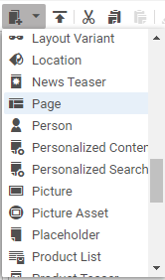

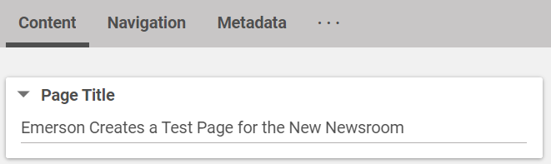
Business as Usual:
Create a Page
Once in the correct folder, click the Create New Content icon in the upper left corner of the library.
Select Page from the dropdown.
Name the Page the full title of the piece of content, “Emerson Creates a Test Page for the New Newsroom” for example.
  If your platform has an established naming convention (“date-truncated-name” for example) continue to use this convention.
Use this same name for the Page Title section on the Content tab.
Give it a Name

Slide 9
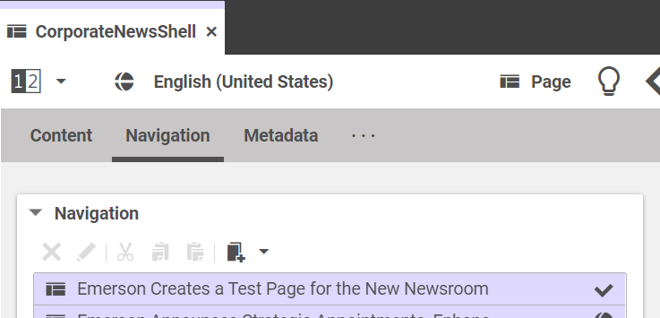

Business as Usual:
Give it a Parent
No change here
Giving the page a Parent is an important step. It defines the URL structure as well as the Header and Footer elements that will be placed on the page. If there is a preview error on the page, chances are you have not given it a parent yet.
To assign the parent page:
Navigate to the appropriate parent page as listed below.
Go to the parent page’s Navigation tab.
Drag the new page into the Navigation section.
Reorder the pages so that the newest page is on top.
Publish the parent page.
PERSPECTIVES ARTICLE
INNOVATION STORY
PRESS RELEASE
IN THE NEWS ALERT
CorporateNewShell
AutomationNewsShell
ComResNewsShell
Perspectives Home
(located in the Corporate file structure)
Innovations Home
(located in the Corporate file structure)
NEWS BRIEF

Slide 10
The Content Tab

Slide 11
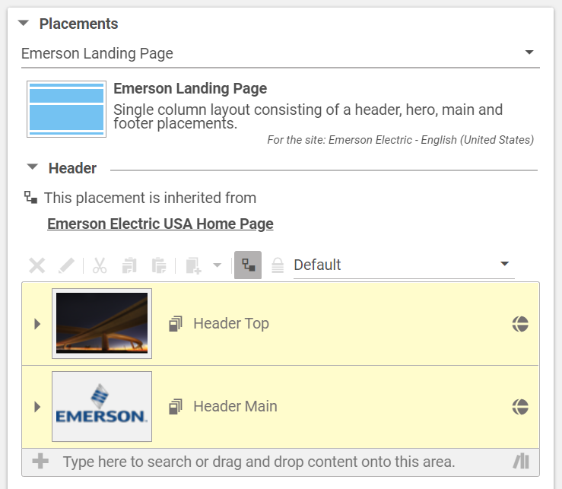

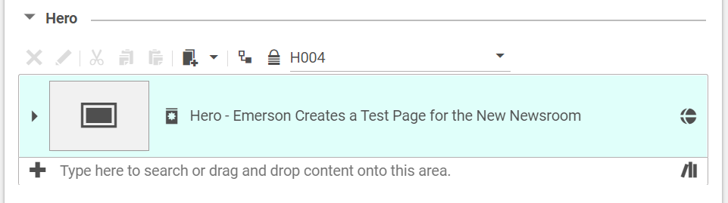
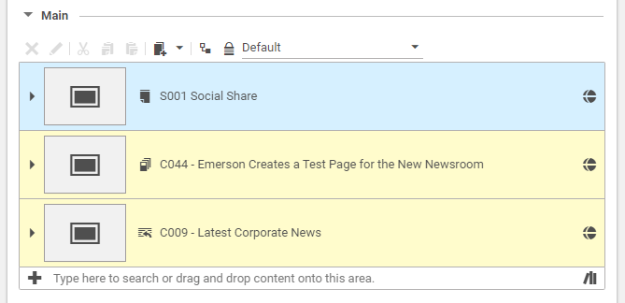
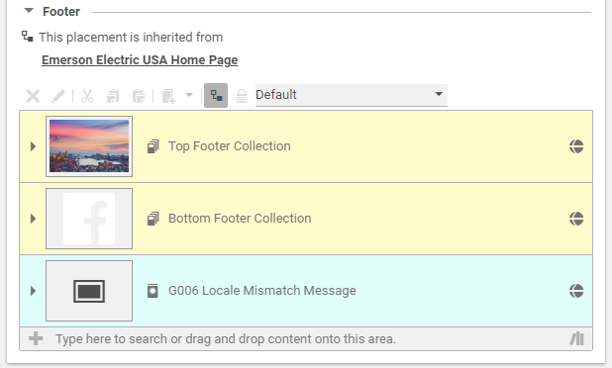
Business as Usual:
The Content Tab
In the Placements section, change to Emerson Landing Page.
In the Header section, make sure the Define Custom Contents icon is selected , that “This placement is inherited from Emerson Electric USA Home Page” is seen, and that the “Header Top” and “Header Main” components are present.
  Sometimes the “Header Top” and “Header Main” components take a minute to appear, but so long as the note “This placement is inherited from Emerson Electric USA Home Page” appears, we should be good.
In the Main section, either paste in existing components or Create New Content based on the Press Release or In the News Alert needs.
  The Resources and Online Style Guide sites contain page layouts and instructions for Press Releases and are being updated with information for In the News Alerts. If there is information you need that is not found on one of these sites, contact Corporate Marketing / the FH CoreMedia team
In the Footer section, make sure the Define Custom Contents icon is selected , that “This placement is inherited from Emerson Electric USA Home Page” is seen, and that the “Top Footer Collection,” “Bottom Footer Collection” and “G006 Locale Mismatch Message” components are present.

Slide 12
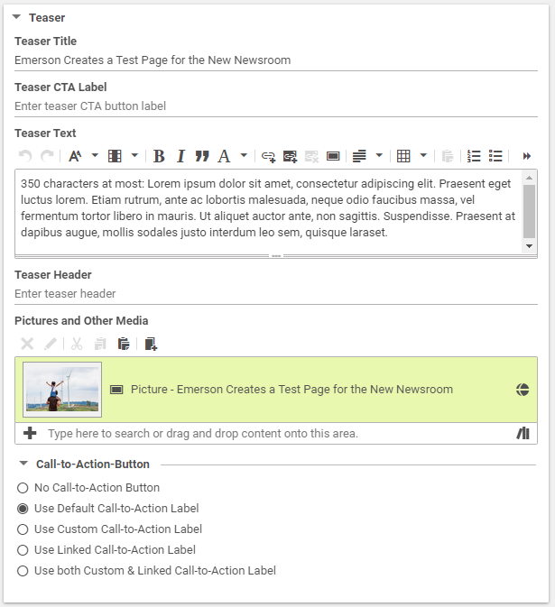
New Process:
Teaser (on the Page, in the Content tab)
On the new content page, on the Content tab:
Add the full title of the content to the Teaser Title section, but know that for the Newsroom Trending News feature, the title will be truncated to about 120 characters.
Add a description to the Teaser Text section. The Trending News feature will truncate this description at 200 characters and the Newsroom Carousels will truncate this 350 characters.
NEW: All pieces of Newsroom content now require an image for the Pictures and Other Media section of the Teaser.
  If this content uses an image in the Hero or a Collection component, use that same image here by dragging that Picture component to this section.
  If you need to create a new component here, click the Create New Content icon.
  Select Picture from the dropdown.
  Name the Picture “Picture – full name of the content…”
  Upload the hero image to the Picture component and set the crops accordingly. See page XX of this deck for notes on Image crops.
Keep the Call-to-Action-Button set to Use Default Call-to-Action Label and this will default to “Read more.”
Can start on this work as of today,
to prepare for launch early May.

Slide 13
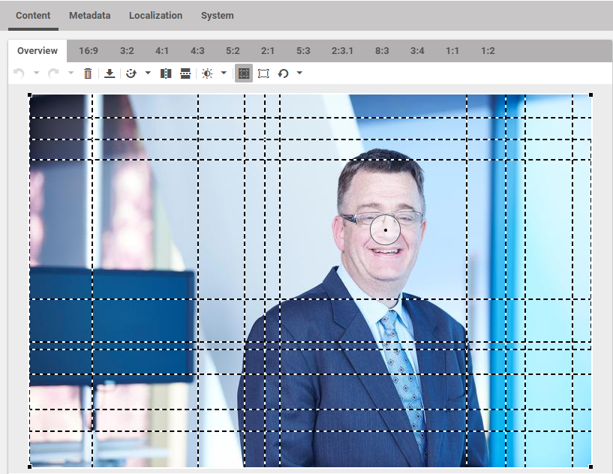
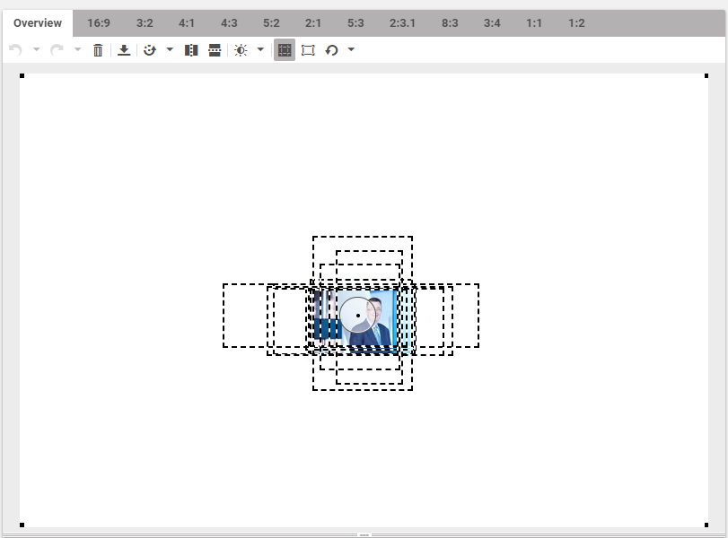
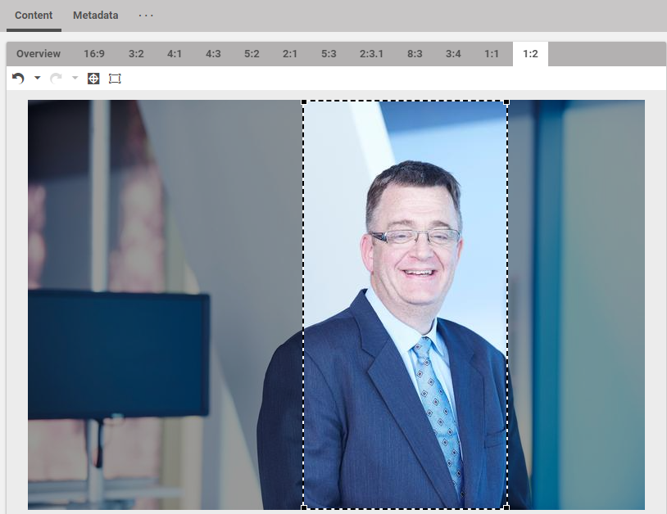
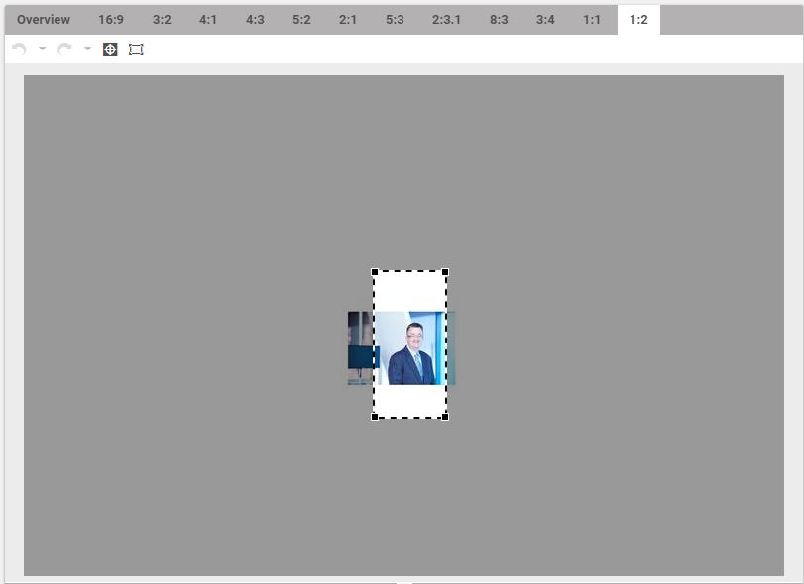
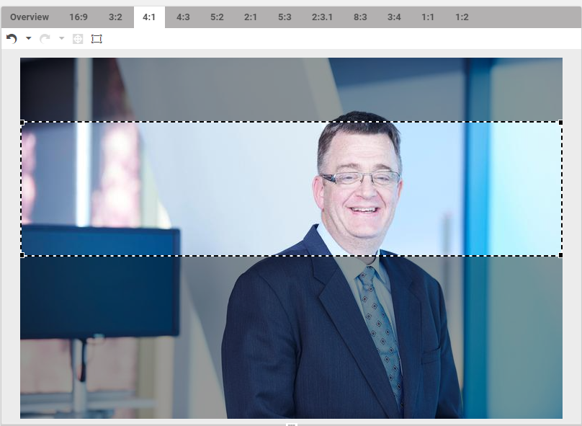
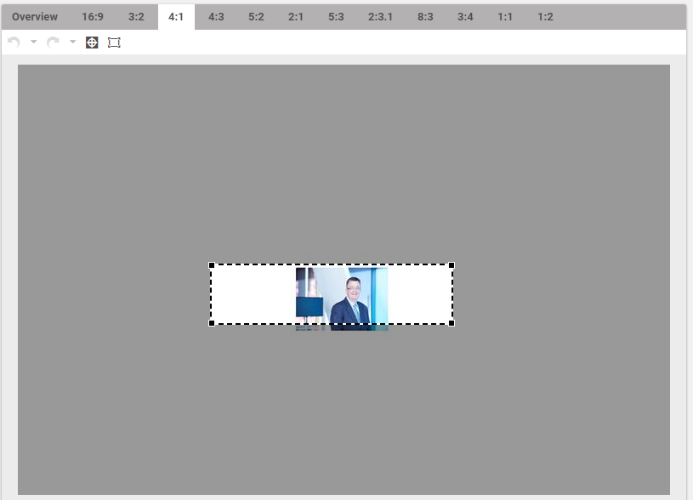
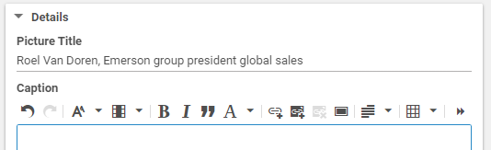
New Process:
Images (in the Teaser)
CORRECT
INCORRECT
All pieces of Newsroom content now require an image for the Pictures and Other Media section of the Teaser. The new look and feel of the newsroom and as well as the individual page layouts are dependent on imagery being uploaded and cropped correctly, according to pre-defined CoreMedia crops.
In the “Assets > [Platform]” folder, create a Picture component.
On the Picture component, upload an image that is high enough resolution and is of a composition that all the pre-defined crops will fit inside of the image edges.
On the Overview tab, begin adjusting the crops, but dragging the focal point (circle with a dot inside of it) to the main subject of the image.
Then check each ratio by selecting the different tabs one-by-one and dragging or resizing the crop box as needed to keep the main subject inside the crop at attractive proportions.
  Do not add white space around an image before uploading it to CoreMedia. This will cause images to not crop correctly for the various components it will be appearing in.
  Do not use the “Fit Image to Crop” option as this will add white space on around the image in CoreMedia and will cause the same issue.
Give your image a meaningful “alt tag” by filling in the Picture Title
See the Online Style Guide or Resources site for specific image size and proportion requirements.
Can start on this work as of today,
to prepare for launch early May.

Slide 14
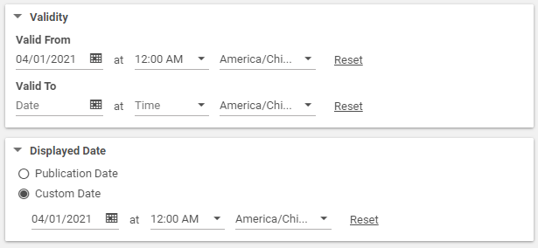
New Process:
Dates (in the Content tab)
All things in the newsroom are based on the “Displayed Date” on each page.
Manually set the Valid From date and time and the Displayed Date and time and make sure that they match exactly.
Can start on this work as of today,
to prepare for launch early May.

Slide 15
The Metadata Tab

Slide 16
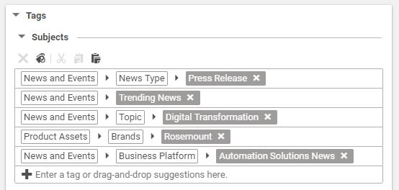
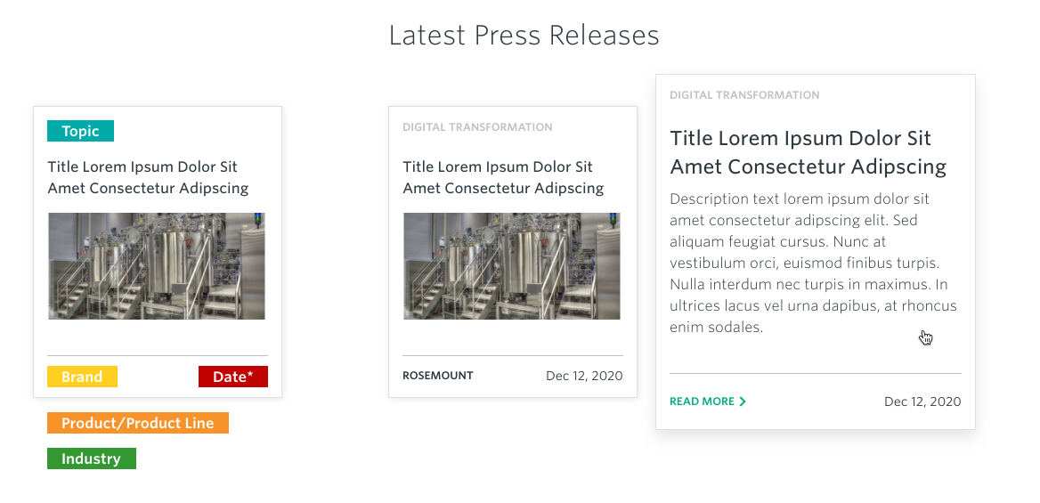
New Process:
Press Release Tags (in the Metadata tab)
Only 1 News Type may be used per newsroom content.
For now, continue using the tag: News and Events > Subjects > Press Release
  We will port this tag to the new one at launch. We will then update the teams to start using the new tag: News and Events > News Type > Press Release
News and Events > Trending News (if it’s hot stuff)
All Press Releases need at least one of the following tags, but more than one may be added if relevant. If more than one of these tags is assigned, the carousel display will pull from the first tag in the list, but the search filters will return search results based on all tags in the list.
News and Events > Topic > [xxx yyy]
Product Assets > Brand and/or Product and/or Industry Segment > [xxx yyy]
News and Events > Business Platform > [xxx yyy News]
Can start on this work as of today,
to prepare for launch early May.

Slide 17
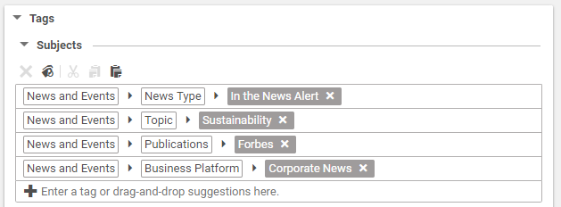
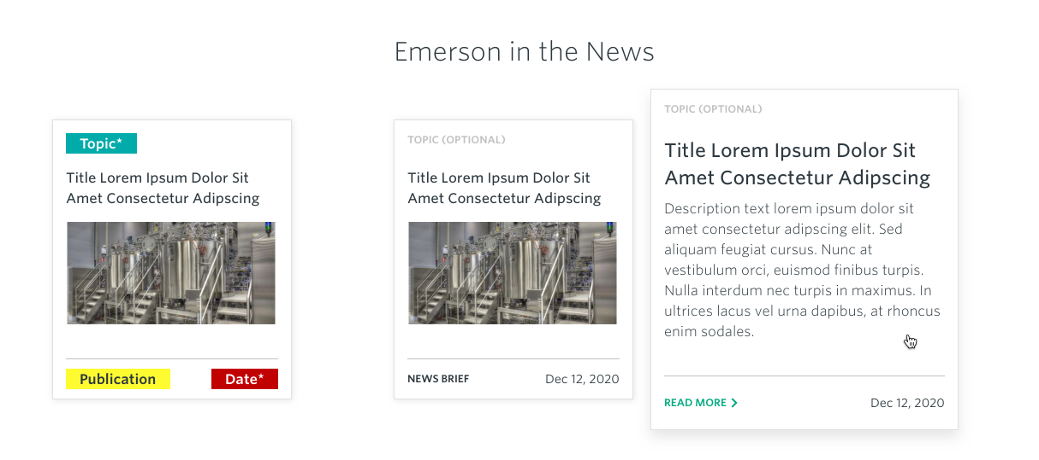
New Process:
In the News Alert Tags (in the Metadata tab)
Only 1 News Type may be used per newsroom content.
News and Events > News Type > In the News Alert
News and Events > Trending News (if it’s hot stuff)
All In the News Alerts need at least one of the following tags, but more than one may be added if relevant. If more than one of these tags is assigned, the carousel display will pull from the first tag in the list, but the search filters will return search results based on all tags in the list.
News and Events > Topic > [xxx yyy]
News and Events > Publication > [xxx yyy]
  Alert the FH CoreMedia team if the publication you need to list is not available in the tags.
News and Events > Business Platform > [xxx yyy News]
Can start on this work as of today,
to prepare for launch early May.

Slide 18
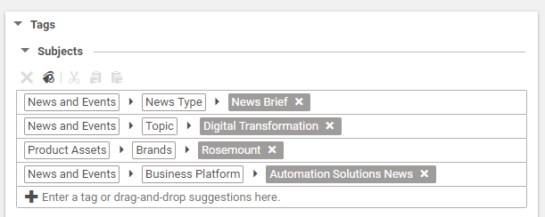
New Process:
News Briefs Tags (in the Metadata tab)
Only 1 News Type may be used per newsroom content.
For now, continue using the tag: News and Events > Subjects > News Brief
  We will port this tag to the new one at launch. We will then update the teams to start using the new tag: News and Events > News Type > News Brief
All News Briefs need at least one of the following tags, but more than one may be added if relevant. If more than one of these tags is assigned, the search results display will pull from the first tag in the list, but the search filters will return search results based on all tags in the list.
News and Events > Topic > [xxx yyy]
Product Assets > Brand and/or Product and/or Industry Segment > [xxx yyy]
News and Events > Business Platform > [xxx yyy News]
News Briefs will not appear in the Newsroom homepage carousels, but they will appear in the News Search page and results, so these tags should be as complete as possible.
Can start on this work as of today,
to prepare for launch early May.

Slide 19
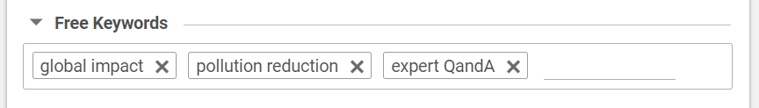
Business as Usual:
Free Keywords (in the Metadata tab)
For all pieces of content, it’s important to identify free keywords that easily summarize the most important point of the subject matter.
These will also help search engines locate the content, the search functions of the Emerson.com website to return meaningful results and for ADA assistive technologies to work the best they can for their users.
Chose meaningful keywords from the page copy.
Reference keyword research if available.
These Free Keywords need to be typed in; they are not chosen from a dropdown list.
Can start on this work as of today,
to prepare for launch early May.

Slide 20
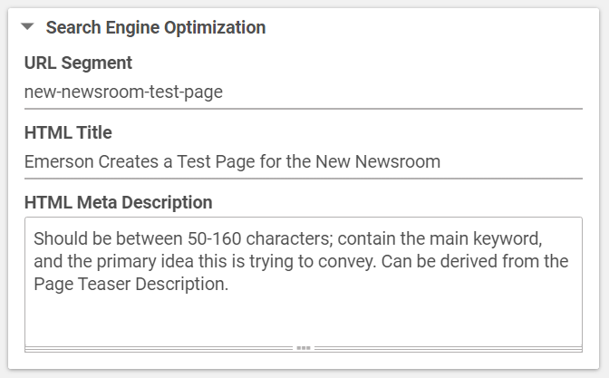
Business as Usual:
SEO (in the Metadata tab)
Further Search Engine Optimization is key for search engines to be able to locate the content, the search functions of the Emerson.com website to return meaningful results and for ADA assistive technologies to work the best they can for their users.
For the URL Segment, page-URL-should-contain-only-meaningful-words in lowercase and using hyphens.
The HTML Title should be kept under 60 characters long. This can be edited down from the full content title if it is lengthy.
  Include keyword(s) if possible.
  No need to include “Emerson” in this title, as the website automatically appends “| Emerson [Locale]” to all HTML Titles.
The HTML Meta Description can be derived from the page Teaser Text description but should be between 50 – 160 characters.
  This should contain the main keyword, and the primary idea this content is trying to convey.
If you need support conducting keyword research or optimizing your content for search engines, contact your platform lead or the FH CoreMedia team.
Can start on this work as of today,
to prepare for launch early May.

Slide 21
Publishing

Slide 22
Slightly New Process:
Proof, Publish, Test, Share
Proofread your Page and all associated components.
Publish the Page.
Test that the Page is appearing as expecting in the:
  Trending News feature (if applicable)
  Appropriate Newsroom Carousel
  Newsroom Search results
Make any adjustments as needed.
  Contact your platform website lead or FH CoreMedia team if you run into issues publishing or troubleshooting.
Share your content via approved email and social communications channels.
Congrats!

Slide 23
Things to Start on Today

Slide 24
Can start on this work as of today, to prepare for launch early May
For ALL NEWS content:
Rename and reorganize existing content. NEWS folders should be:
  Press Releases
  In the News Alerts
  News Briefs (if needed)
  Ancillary folders as needed (NOTE: we are not changing any EVENTS folders or content organization)
For NEWS content in 2021, 2020 and any important content from prior years:
Populate Page Teaser content in the Content tab (this will be used instead of News Teasers going forward), including adding an Image
As your adding Images to the Page Teaser, check that crops are set correctly and that each image has a meaningful Title
Manually set the Valid From date and time and the Displayed Date on the Page
Update the CoreMedia tags on the Metadata tab as needed to add Topic, Brand, Product, Industry Segment, Publication, Business Platforms, etc.
Fill in Free Keywords on the Metadata tab if needed
Make sure SEO fields are populated

Slide 25
Appendix

Slide 26
Additional Publishing Resources
Online Style Guide: https://osg.emerson.com/
L022A – News and Events Article – 2 Column: https://osg.emerson.com/l022a-news-and-events-article-2-column/
L022B – News and Events Article – 1 Column: https://osg.emerson.com/l022b-news-and-events-article-1-column/
L026 Case Study: https://osg.emerson.com/l026-case-study/
Image Guidelines: https://osg.emerson.com/image-guidelines/
Resources site: https://d5-auth.emerson.com/en-us/resources
Component Quick Reference: https://d5-auth.emerson.com/en-us/resources/content-management/quick-reference with links to Author instruction pages + Regression pages + OSG pages
Image Guidelines: https://emerson.sharepoint.com/:b:/s/Digital-Engagement/EbmRXdJA6JlCjbzEz0qpRdUBTfeqHSVP2TgWbVmRYfQ8-Q?e=TCWg5N
Newsroom Copy Deck: Emerson-com-Newsroom_COPY_DECK

Slide 27
URL Structure
Newsroom Homepage: /news (Searching in the hero search bar will require you to go to a new page for the search results. See below.)
Landing pages (search results page with filters pre-selected to this news type – and potentially some featured or intro content above and additional resources below):
  Search results from the Newsroom Homepage hero search bar: /news/search
  Latest Press Release: /news/latest-news/ (searches in the hero search bar would keep you on this page without changing the URL)
  Innovations: /innovation (searches in the hero search bar would keep you on this page without changing the URL)
  Perspectives: /perspectives (searches in the hero search bar would keep you on this page without changing the URL)
  Emerson in the News: /news/emerson-press/ (searches in the hero search bar would keep you on this page without changing the URL)
News type pages therefore would be
  Latest Press Release: /news/corporate/Emerson-released-some-financial-information-today
  or /news/commercial-residential/look-at-these-cool-new-drain-cleaners
  or /news/automation/look-at-these-cool-new-drain-cleaners
  Innovations: /innovation/heres-a-cool-story-about-our-tech-and-tools-doing-something-great-for-society
  Perspectives: /perspectives/this-is-an-opinion-piece-from-one-of-our-subject-matter-experts
  Emerson in the News: /news/corporate/CNN-Forbes-or-Engineers-Daily-said-something-cool-about-us
  or /news/commercial-residential/CNN-Forbes-or-Engineers-Daily-said-something-cool-about-us
  or /news/automation/CNN-Forbes-or-Engineers-Daily-said-something-cool-about-us

Slide 28
Additional Contacts
FLEISHMANHILLARD
FH-EMR_Core_Media_Team@fleishman.com
Mary Foshage: mary.foshage@fleishman.com
Melissa Dorn: melissa.dorn@fleishman.com
CORPORATE
John Altmix: john.altmix@emerson.com
AUTOMATION SOLUTIONS
Grace Capwell: grace.capwell@emerson.com
COMMERCIAL & RESIDENTIAL SOLUTIONS
Jenna Petroff: jenna.petroff@emerson.com

