Slide 1


Making the World Healthier, Safer, Smarter and More Sustainable
Company Overview | 2021

Slide 2

Company Profile
Emerson (NYSE: EMR) is a leading global technology, software, engineering and manufacturing company providing innovative solutions for customers in industrial, commercial and residential markets.
OUR TWO GLOBAL BUSINESS PLATFORMS
Automation Solutions helps process, hybrid and discrete manufacturers maximize production, protect personnel and the environment while optimizing their energy and operating costs.
Commercial & Residential Solutions helps ensure human comfort and health, protect food quality and safety, advance energy efficiency and create sustainable infrastructure.
OUR PURPOSE
We drive innovation that makes the world
healthier, safer, smarter and more sustainable.

Slide 3
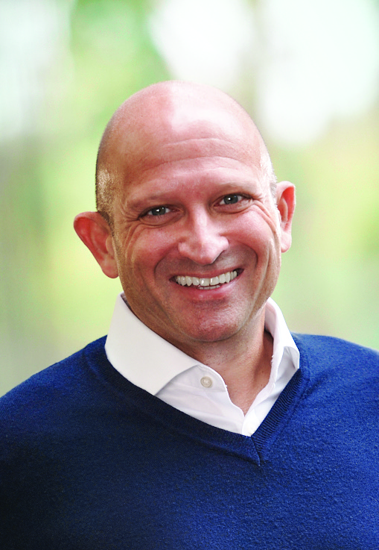
Message From Our CEO
For more than 130 years, Emerson has been a partner of choice to the world’s most essential industries. It’s through our talented global workforce, advanced technologies and exceptional service that we’ve strengthened this leadership position.
Now it’s time to charge forward – to build upon our impressive legacy, advance our business with intention, expand our inclusive culture and continue to build the foundation for a stronger future.
Driven by the energy of transformation, we’re seizing the opportunity to think differently, catalyzing creative investing, taking bold and decisive action, and reimagining the Emerson – and the world – of tomorrow.
Lal Karsanbhai
President and Chief Executive Officer

Slide 4


2021 AT-A-GLANCE
FOUNDED
1890
TWO
BUSINESS
PLATFORMS
$11.6B
$6.7B
IN SALES
IN SALES
HEADQUARTERS IN
AUTOMATION SOLUTIONS
COMMERCIAL & RESIDENTIAL SOLUTIONS
ST. LOUIS, MO USA
$18.2
BILLION
3
COVID-19
VACCINES
NYSE:
EMR
65
YEARS
CONSECUTIVE YEARS OF INCREASED DIVIDENDS
PRODUCED
USING EMERSON’S SOFTWARE
IN GLOBAL SALES
FISCAL YEAR 2021
WORLDWIDE
86,700
EMPLOYEES
INNOVATION
#181
FORTUNE 500
AMERICA’S LARGEST CORPORATIONS BY REVENUE
EMERSON
EMPLOYEES HELD
170
MANUFACTURING
LOCATIONS
20K
ACTIVE PATENTS
WORLDWIDE
IN 2021
RECOGNITION - 2021
TOP 50 EMPLOYERS
WOMEN ENGINEERS
MAGAZINE
BEST EMPLOYERS FOR DIVERSITY
FORBES MAGAZINE
IoT ANALYTICS PLATFORM OF THE YEAR
IOT BREAKTHROUGH

Slide 5
Emerson Global Sales 2021 — $18.2 Billion
EUROPE
$3.3B
18%
COMMERCIAL & RESIDENTIAL SOLUTIONS
$6.7B
36%
AMERICAS
$9.6B
53%
2021 SALES
BY PLATFORM
2021 SALES
BY GEOGRAPHY
AUTOMATION SOLUTIONS
$11.6B
64%
ASIA, MIDDLE EAST & AFRICA
$5.3B
29%
57% of 2021 destination sales were outside the U.S.

Slide 6
Emerson Global Presence 2021
GLOBAL
EUROPE
$3.3 BILLION SALES 19,800 EMPLOYEES 50 LOCATIONS
UNITED STATES AND CANADA
$8.6 BILLION SALES 22,700 EMPLOYEES 60 LOCATIONS
$18.2B
SALES
ASIA
$4.3 BILLION SALES 25,900 EMPLOYEES 35 LOCATIONS
86,700
EMPLOYEES
LATIN AMERICA
$1.0 BILLION SALES 16,200 EMPLOYEES 20 LOCATIONS
170
LOCATIONS
MIDDLE EAST / AFRICA
$1.0 BILLION SALES 2,100 EMPLOYEES 5 LOCATIONS
Note: Locations include manufacturing locations only.

Slide 7
Delivering Shareholder Value
$3.82
EARNINGS
PER SHARE (GAAP)
65
CONSECUTIVE YEARS
OF INCREASED DIVIDENDS
Emerson’s (NYSE: EMR) people, processes and investments are focused on building sustainable long-term value for shareholders – 65 years and counting.
$2.02
DIVIDENDS
PER SHARE
1956
2021

Slide 8
Our Business Platforms

Slide 9
Automation Solutions
2021 At-A-Glance
$11.6B
SALES
~56,100
EMPLOYEES
AMERICAS
44%
ASIA, MIDDLE EAST & AFRICA
35%
SALES BY GEOGRAPHY
CUSTOMERS INCLUDE
Amgen, BASF, BP, Cargill, Colgate-Palmolive,
Dow, Duke Energy, Equinor, Novo Nordisk, Reliance Industries, Sasol, Saudi Aramco, Shell, Sinopec
EUROPE
21%

Slide 10
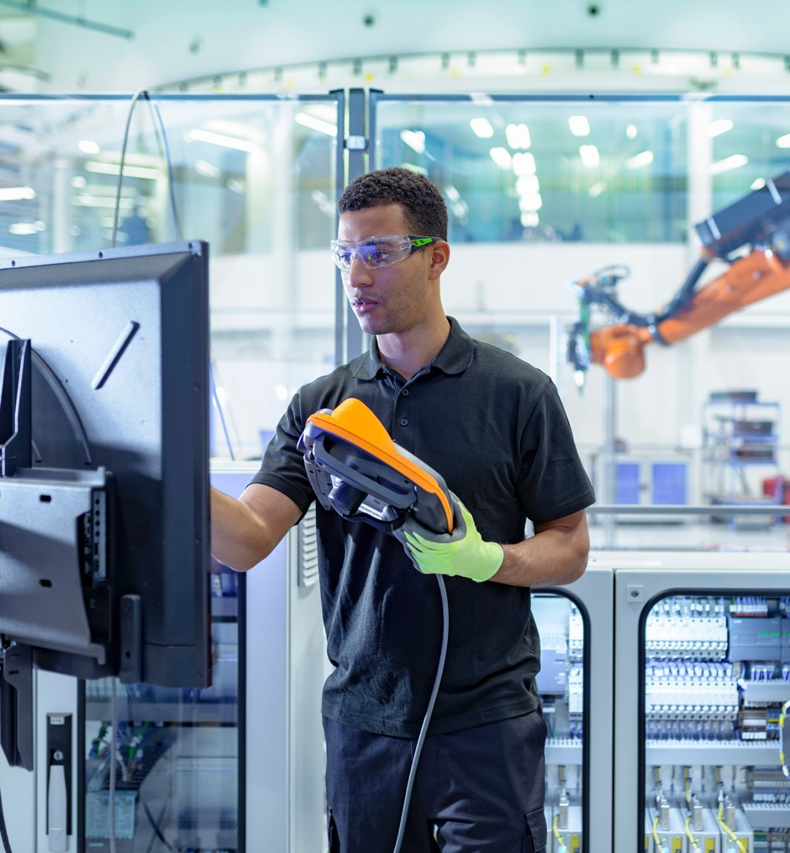
Automation Solutions
Improving Process, Discrete Automation and Hybrid Industrial Manufacturing Performance with Measurable Results
INDUSTRIES SERVED
Life Sciences & Medical
Chemical
Power
Food and Beverage
Packaging, Pulp and Paper
Marine
Oil and Gas/Refining
Mining, Minerals and Metal
Water and Wastewater
Automotive
Industrial Energy
Onsite Utilities
Software
PRODUCT BRANDS & SERVICES
Industrial Internet of Things
Plantweb™ Digital Ecosystem
Software and Systems
AMS
DeltaV
OSI
Ovation
PACSystems
Zedi
MoviCon
Syncade
Measurement Instrumentation
Rosemount
Micro Motion
Fluid Control & Pneumatics
ASCO
AVENTICS
Valves, Actuators and Regulators
Bettis
Fisher
Keystone
KTM
Vanessa
Materials Joining, Assembly and Cleaning
Branson
HTE
Electrical and Lighting
Appleton
Notes:
10
10

Slide 11
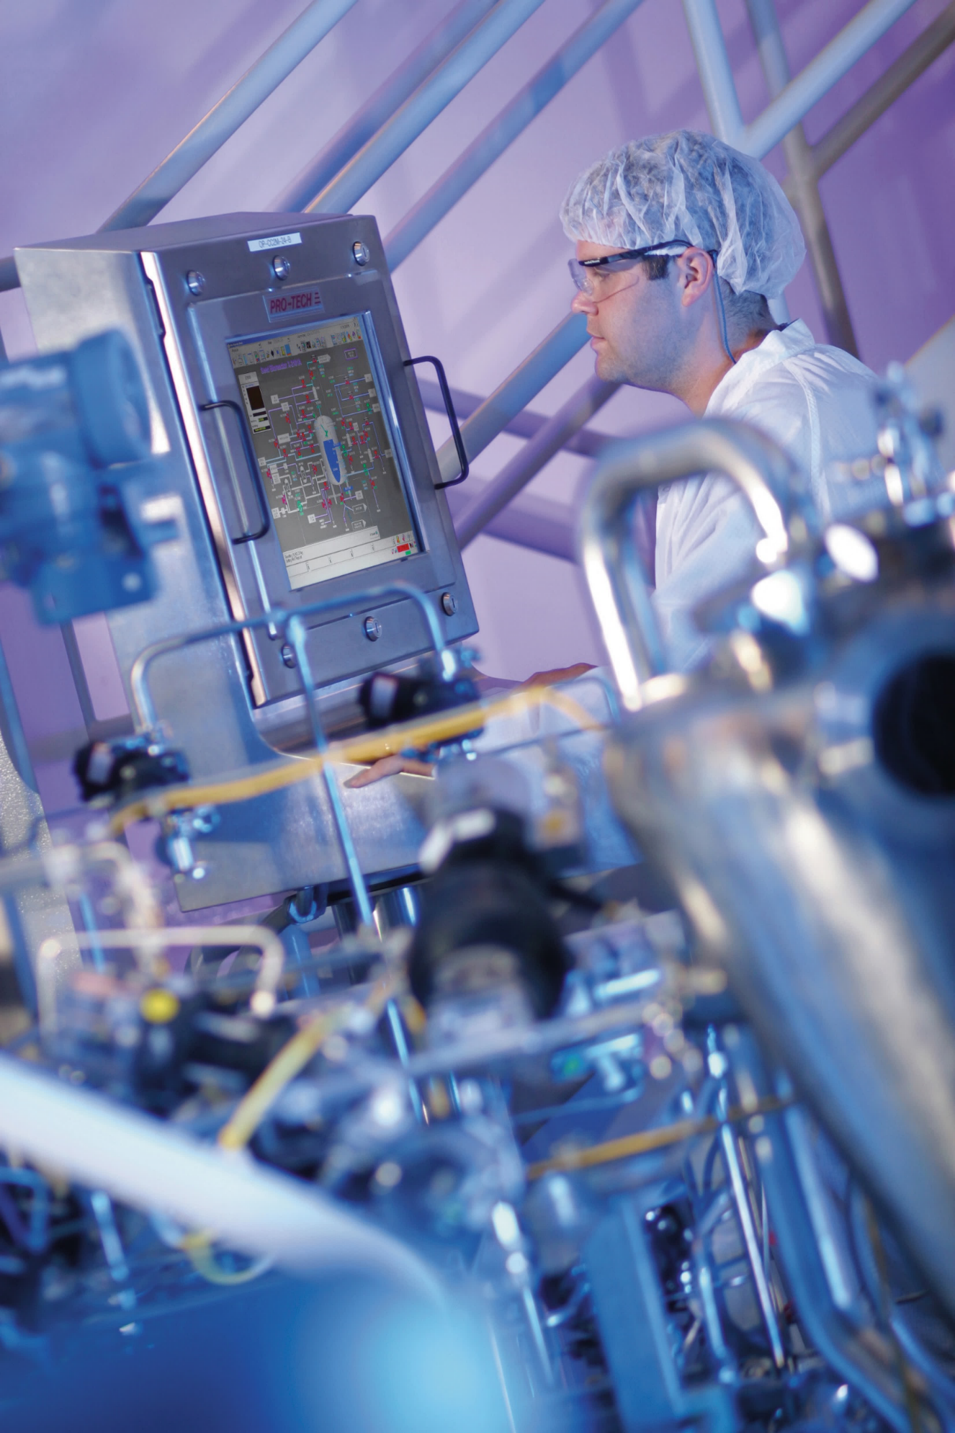
Automation Solutions
Enabling Top Quartile Results
OPERATIONAL CERTAINTY
PROJECT CERTAINTY
Our technology- and engineering-based program is designed to help industrial companies achieve Top Quartile performance and recover more than $1 trillion in estimated operational losses globally.
We combine innovative technology
and engineering to improve capital efficiency and boost project schedule reliability—helping to address the billions of dollars lost
due to project excesses each year.
PLANTWEB DIGITAL ECOSYSTEM
  Our Plantweb digital ecosystem, the 2020 Edison Award winner in
  Innovative Services, provides a robust portfolio of hardware, software,
  intelligent devices and services for securely implementing the Industrial
  Internet of Things, with measurable business performance improvement.
Notes:
11
11

Slide 12
Commercial & Residential Solutions
2021 At-A-Glance
SALES BY
SEGMENT
CLIMATE TECHNOLOGIES
71%
TOOLS & HOME PRODUCTS
29%
$6.7B
SALES
~28,100
EMPLOYEES
CUSTOMERS INCLUDE
Amazon, Carrier Global Corporation, Daikin-Goodman, HD Supply, The Home Depot, Johnson Controls, Johnstone Supply, Lennox, Lowe’s, Midea, Rheem, Trane Technologies, United Refrigeration, Wolseley, W.W. Grainger
AMERICAS
68%
ASIA, MIDDLE EAST & AFRICA
19%
SALES BY GEOGRAPHY
EUROPE
13%

Slide 13




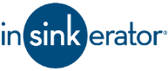


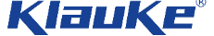
Commercial &
Residential Solutions
Transforming the Way People Live
and Work Globally
INDUSTRIES SERVED
OUR PRODUCT BRANDS
Residential Construction & Home Improvement
Commercial Buildings & Construction
Energy & Utilities
Facility Management & Maintenance
Food Service & Hospitality
Food Retail
Healthcare & Life Sciences
Transportation
MARKETS SERVED
Heating & Air Conditioning Technology
Cold Chain Software & Technology
Real-time tracking and data services
Refrigeration and cold storage
Temperature and environmental monitoring
Energy & Facility Management Solutions
Smart Thermostats
Home Improvement, Repair & Maintenance
Professional Tools
Commercial Comfort & Cleaning
Food Waste Management
Notes:
13
13

Slide 14

Commercial & Residential Solutions
Key Initiatives
ENERGY EFFICIENCY,
EMISSIONS MANAGEMENT, DECARBONIZATION & SUSTAINABILITY
Our Copeland™ compressors and related technologies help air conditioning and refrigeration equipment reach new levels
of efficiency, meet environmental regulations
for low GWP and natural refrigerants and drive the adoption of heat pumps and other higher efficiency electric systems.
FOOD QUALITY, SAFETY & SUSTAINABILITY
Our Copeland™ and Lumity™ cold chain solutions provide the food industry with sustainable refrigeration technologies,
in-transit cargo tracking and onsite
temperature management.
Our InSinkErator™ food waste disposers
enable convenient, hygienic and sustainable food waste management at home and in commercial kitchens.
HUMAN HEALTH & COMFORT
Our Sensi™ and Verdant™ thermostats provide greater comfort and smart energy management for residential and commercial indoor spaces, while our integrated control and monitoring solutions help ensure safe transport and storage of critical vaccines and pharmaceuticals.
INFRASTRUCTURE MANAGEMENT, PRODUCTIVITY & SAFETY
Our RIDGID™, Greenlee™ and Klauke™ brands provide professionals and do-it-yourselfers with quality, safety-minded mechanical, electrical and plumbing tools.
We are also investing in digital features and education and training initiatives to attract and develop the next generation of skilled workers.

Slide 15
More About
Our Company

Slide 16





Emerson Has a Culture That is Driven to Create Value for Its Employees, Customers and Shareholders
OUR PURPOSE
Overarching Goal that Guides
Us, The Impact or Change
We Can Make in the World
We Drive Innovation That Makes The World
Healthier, Safer, Smarter and More Sustainable
THE EMERSON MANAGEMENT PROCESS
Puts Our Values in Action
THE EMERSON MANAGEMENT PROCESS
OUR CAUSES
Aspirations and Activities
that Provide Proof Behind
Our Purpose
Planet
Humanity
Champion
Inclusion
Future
OUR VALUES
Foundation of Our Character and Behavior
Integrity
Continuous Improvement
Safety & Quality
Collaboration
Support
Our People
Innovation
Customer Focus
Notes:
Values:
Emerson’s Values are the foundation of our character and behavior. Guardrails for how we make decisions, act and react.
Causes:
Specific examples of our aspirations and activities that provide proof behind our Purpose.
Purpose:
Purpose functions as a North Star. It serves as a single overarching goal that guides the company. Reason for being beyond profit. Describes what impact or changes the company can make in the world.
In 2016 we established our single set of shared Values. We have now built on that solid foundation and uncovered our Purpose and Common Causes.
One Purpose statement and a single set of Causes is a crucial step in our transformation to One Emerson.
Hallmarks of a great purpose are:
Authenticity
Contemporary yet timeless
Personal and owned by everyone
Recognizable and visible – lived from within demonstrated outward
Causes – where we tell the compelling stories that convey our sense of identity & professional purpose.
This is where a company’s aspirations become reality with specific proof points.
Planet: for sustainability
Humanity: health comfort and safety
Champion: is all about stewarding our customers thru regulatory and economic challenges.
Inclusion: supports our environment of fairness, trust and support
Future: STEM education is all about the future of our employees and industry customers
We will provide 5 short individual Cause videos celebrating our Purpose based innovations and acquisitions.

Slide 17

OUR PURPOSE
We drive innovation that makes the world
healthier, safer, smarter and more sustainable.
HEALTHIER
SAFER
SMARTER
MORE SUSTAINABLE
Our expertise and technologies
in life sciences, food and beverage, the cold chain and environmentally responsible home comfort are helping make
it more possible than ever for humans to live comfortable and health-conscious lives.
We help bring critical new life-saving medicines to market faster with consistently high quality.
Our cold chain technologies enable our customers to safely keep perishable food and drugs at proper temperatures.
We are helping customers reduce risk, protect employees and communities, and operate with increased reliability and certainty.
We keep our customers safe with our location tracking software that provides real-time worker safety monitoring, potentially reducing more than 70 percent of common industrial incidents.
Our new-to-the-world insulated hydraulic tools help keep linemen and electrical contractors protected against shocks and hazards.
Our advanced technologies
have transformed the ways our customers operate, empowering improvements in efficiency, productivity, reliability and profitability.
We make plants smarter by helping process engineers optimize operations with our digital twin software.
Our ENERGY STAR-certified Sensi smart thermostat technology uses geo-fencing, remote access, and flexible scheduling to keep homeowners in the know and in control of their home comfort.
Our technologies and expertise are helping customers achieve sustainability targets, fulfill environmental regulations and implement responsible solutions.
We promote sustainability with innovative software that enables the global power industry to seamlessly incorporate renewable energy sources to modernize and improve the reliability of the electric grid.
Our energy efficient compressors enable our industry partners to comply with ever-rising government efficiency standards for air conditioning and refrigeration systems.

Slide 18





Our Causes
Commitments We Make to Act Responsibly
PLANET
We deliver sustainable solutions that improve efficiency, reduce emissions and conserve resources.
HUMANITY
We strive to advance health, comfort, food quality and safety.
CHAMPION
We lead our customers through complex technical, regulatory and economic challenges.
INCLUSION
We cultivate an environment based on trust and support.
FUTURE
We promote STEM education and programs that prepare the next generation of critical thinkers and problem solvers.

Slide 19

Our Values
Guiding How We Operate Internally & Externally
INTEGRITY
We are uncompromising in our honest and ethical behavior, which creates trusting relationships with one another, customers, suppliers and communities.
CONTINUOUS IMPROVEMENT
We constantly strive for improvement in all aspects of our business, guided by metrics, feedback and our disciplined management process.
SAFETY & QUALITY
We are unwavering in our commitment to the highest standards of safety and quality for ourselves and our customers.
COLLABORATION
We work seamlessly across geographies, platforms, business units, and functions to fully leverage our unmatched breadth and expertise.
SUPPORT OUR PEOPLE
We attract, develop and retain exceptional people in an inclusive work environment, where all employees can reach their
greatest potential.
INNOVATION
We passionately pursue new technologies, capabilities and approaches to drive tangible value for our customers.
CUSTOMER FOCUS
We actively listen to our customers to
deeply understand their needs and deliver the unique solutions that ensure their success.

Slide 20

SOCIAL
Building a more inclusive workplace
Setting a goal to double our representation of women globally and U.S. minorities at the leadership level by 2030
Supporting our communities
Allocating $24.5M in U.S. charitable contributions in 2020
Advocating for education
and STEM skills
Donating $3M in U.S. for STEM education
2020 ESG Report Highlights
Read our most recent report at Emerson.com/ESG
ENVIRONMENTAL
GREENING
OF EMERSON
GREENING
BY EMERSON
GREENING
WITH EMERSON
GOVERNANCE
Improving our
internal sustainability performance by:
Reducing GHG emissions intensity by 20% by 2028
Enlisting our energy providers, supply chain partners and logistics services to support similar objectives
Embedding sustainability
focus throughout our management process
Providing products, expertise, solutions and services to help our customers transition to lower carbon by:
Energy source decarbonization
Emissions management
Electrification and system integration
Energy efficiency and optimization
Fostering collaboration among external
stakeholders by:
Partnering to develop
innovative solutions
Participating in sector and customer initiatives
Sharing our expertise to
shape future policy developments globally
Ensuring diversity representation
on our Board of Directors in terms of women, persons of color or of a diverse nationality
Formalizing Board’s commitment
to ESG oversight
Designating independent Board chair,
as of May 2021

Slide 21




Strengthening Our Workplace Through Diversity, Equity and Inclusion
EMPLOYEE RESOURCE GROUPS
Employee Resource Groups established within Emerson to help support and
promote a diverse, equitable and inclusive work environment include:
Women’s Impact Network
Provides support and networking opportunities for our woman employees globally.
Black Employee Alliance
Drives strategic recruiting, retention and advancement initiatives in support of our
Black employees.
Veterans
Raises awareness of the value U.S. military veterans bring to our organization.
LGBTQ + Allies
Empowers our LGBTQ employees and their workplace allies to foster a diverse and inclusive company culture.
Somos
Focuses on support and engagement initiatives
on behalf of our Hispanic and Latin American employees.
Asian and Pacific Islanders Alliance
Provides a platform to spotlight contributions
and foster relationships with our Asian and Pacific Islander colleagues.
Diverse Abilities
Encourages awareness of the effect of discrimination and social exclusion around perceived impairments and/or disabilities.
MOSAIC
Fosters community for people working away
from their home country.
2021 ACTIONS
Announced goal to double the representation of
women globally and U.S. minorities at the leadership levels by 2030.
Hired our first-ever chief people officer, Elizabeth Adefioye.
Launched company-wide DE&I award program to recognize employees who demonstrate an exceptional commitment to DE&I.
Partnered with HBCU Career Development Marketplace to enhance our diverse candidate recruiting.
Continued to establish mentorship programs on local, business unit and employee resource group levels.
Expanded our “Courageous Conversations” series on equity perspectives to more global regions.
2021 DE&I RECOGNITIONS

